Slide 1


<Andrew Hirst>
<11th June 2024>

Slide 2

Outline
Executive Summary
Introduction
Methodology
Results
Conclusion
Appendix

Slide 3
Executive Summary
Summary of methodologies
Data collection via Pandas
Data collection API keys
Using Mapping via Folium
Machine learning for the predictions
Summary of all results
Data is illustrated via Tables & charts with some charts showing predictions.

Slide 4
Introduction
Project background and context
SpaceX advertises Falcon 9 rocket launches on its website with a cost of 62 million dollars; other providers cost upward of 165 million dollars each, much of the savings is because SpaceX can reuse the first stage. Therefore if we can determine if the first stage will land through producing was probability models with Python/Machine Learning, we can determine the cost of a launch. This information can be used if an alternate company wants to bid against SpaceX for a rocket launch.
Problems you want to find answers
Does the launch site effect the probability of the rocket successfuly launching or not.
The interaction amongst various features that determine the success rate of a successful landing.
What operating conditions needs to be in place to ensure a successful landing program.

Slide 5

Section 1

Slide 6
Methodology
Executive Summary
Data collection methodology:
Data was collected via a API key then converted into a json file to normalize the data prior to conversion to a dataframe
Perform data wrangling
Using One Hot encoding applied to categorical columns in the data.
Perform exploratory data analysis (EDA) using visualization and SQL
Perform interactive visual analytics using Folium and Plotly Dash
Perform predictive analysis using classification models
How to build, tune, evaluate classification models

Slide 7
Data Collection
The data was collected using the various methods :-
Using the API from SpaceX to obtain the data.
Loaded into a JSON File, which was then converted into a Pandas dataframe.
Data was then cleaned for missing data using averages to fill the missing gaps.
We then run the data through some Machine Learning models and then compare which one gives the most acurate prodictions.

Slide 8
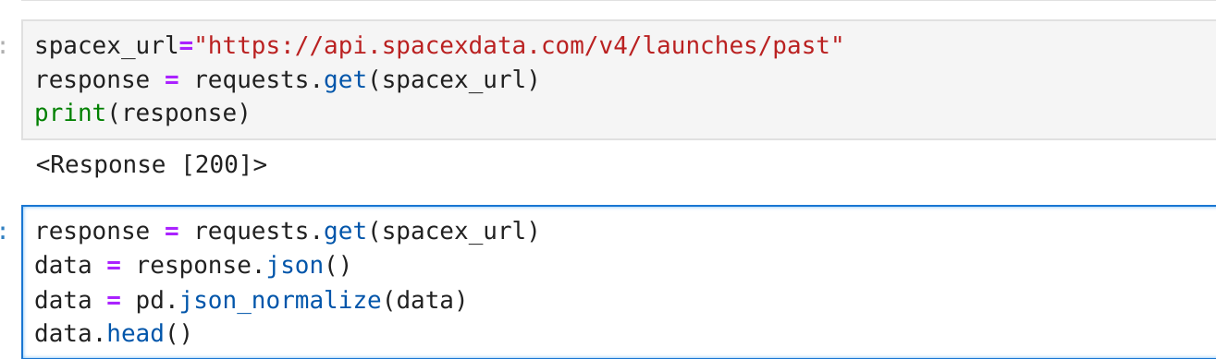
Data Collection – SpaceX API
We firstly load the SpaceX Data from a API (http) address then load the response content into a json file to normalize the data before converted into a dataframe.
Add the GitHub URL of the completed SpaceX API calls notebook (must include completed code cell and outcome cell), as an external reference and peer-review purpose
Place your flowchart of SpaceX API calls here

Slide 9
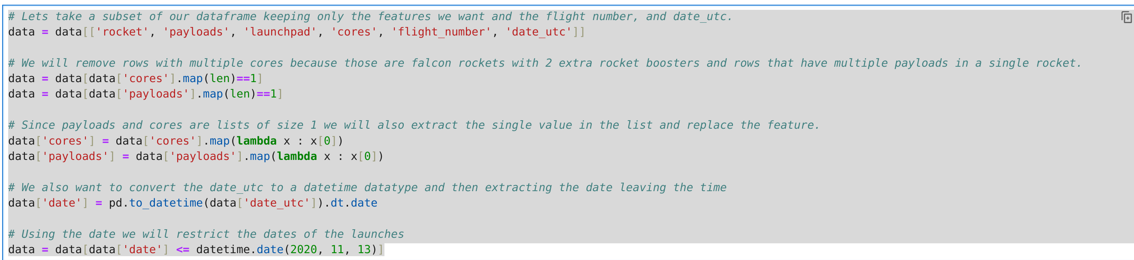
Data Collection - Scraping
You will notice that a lot of the data are ID’s. For example the rocket column has no information about the rocket just an indentification number,so we will use the API again to get the information.
Add the GitHub URL of the completed web scraping notebook, as an external reference and peer-review purpose

Slide 10
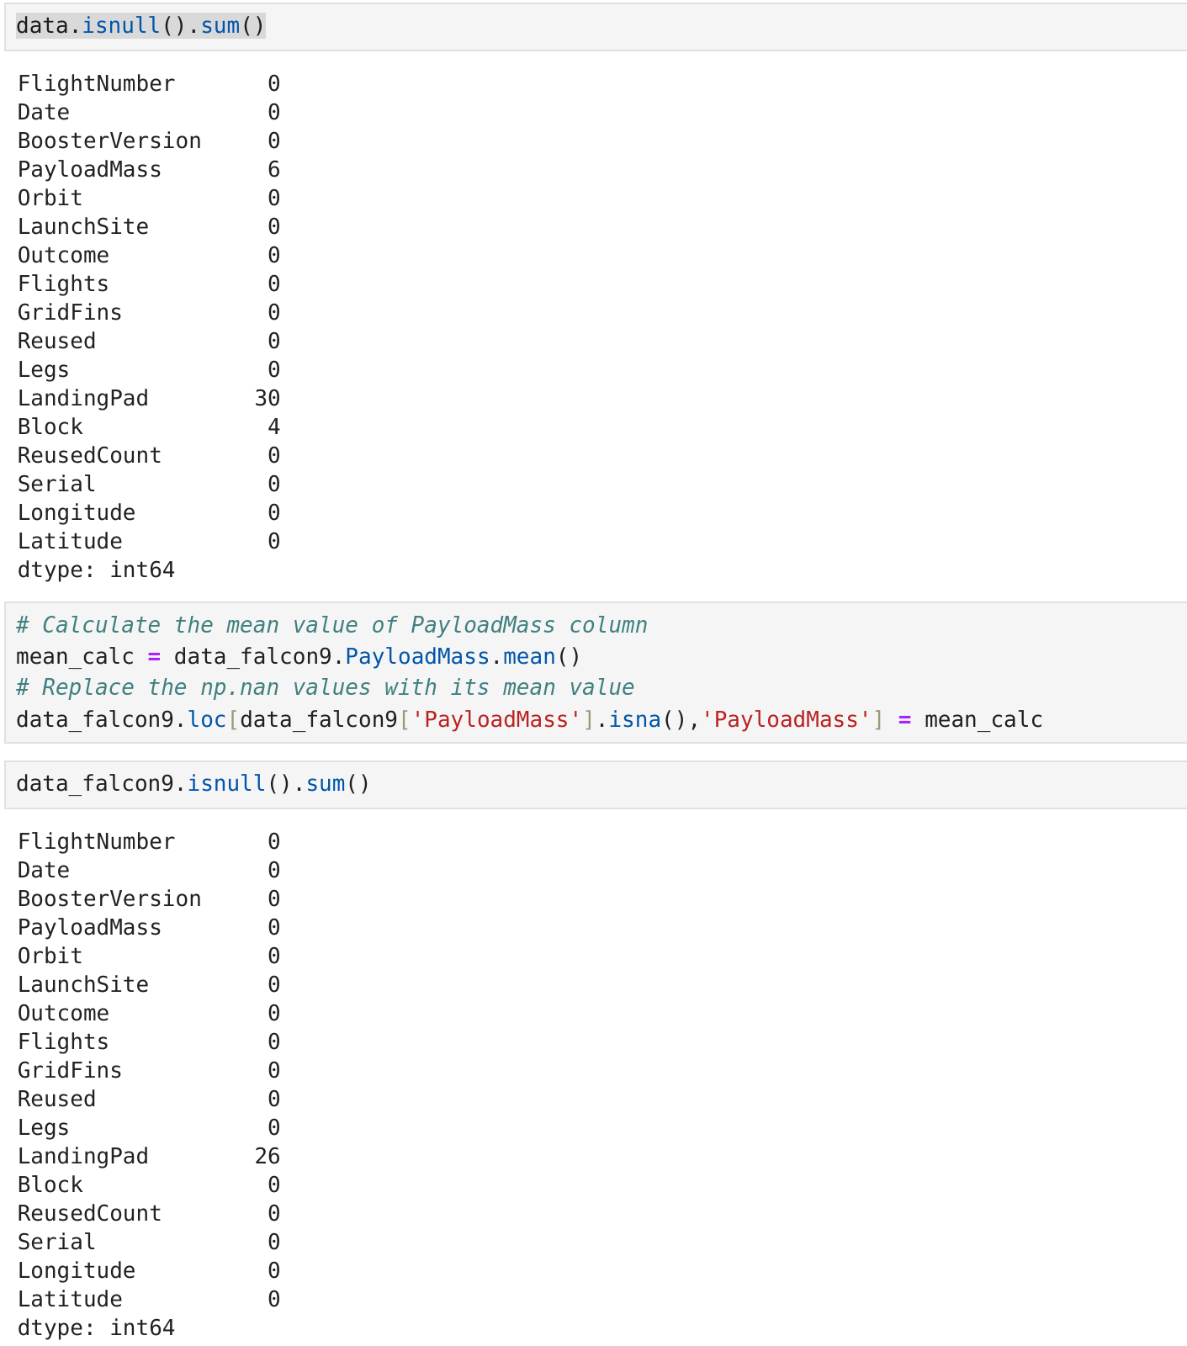
Data Wrangling
We notice in the table under the PayloadMass column with have some nulls as confirmed ->
We will replace these NAN values with the mean average.Add the GitHub URL of your completed data wrangling related notebooks, as an external reference and peer-review purpose

Slide 11
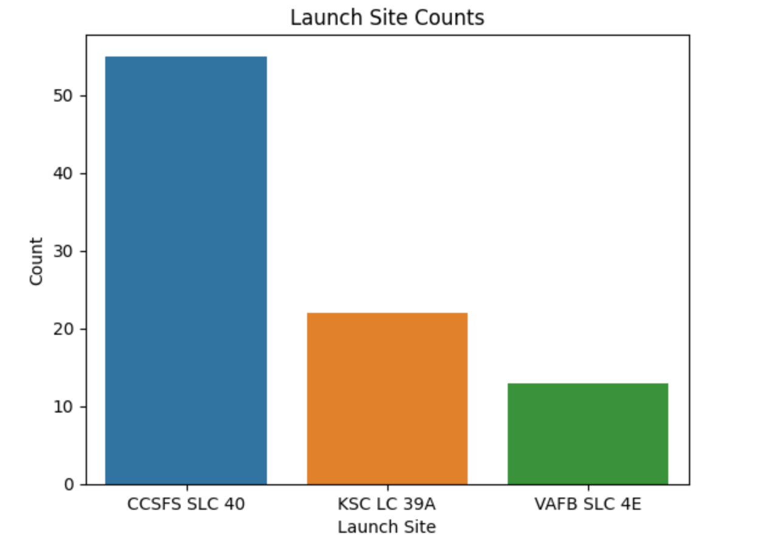
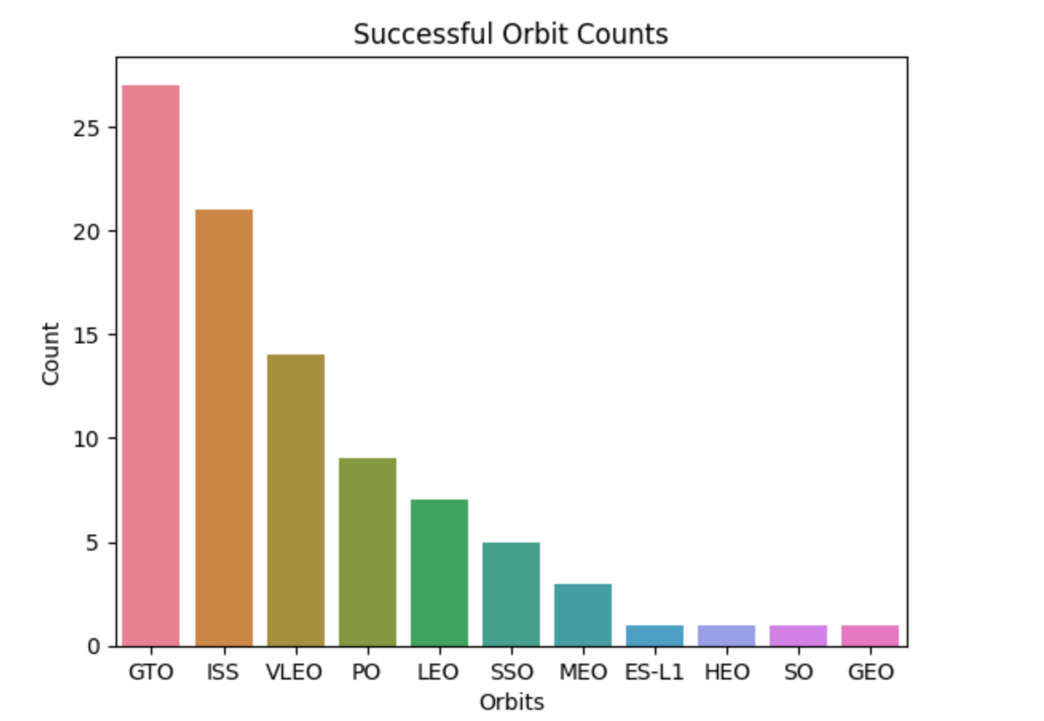
EDA with Data Visualization
We firstly looked at the number of successfull launches between the launch sites and also the number of orbits with Barcharts as per below:-
Add the GitHub URL of your completed EDA with data visualization notebook, as an external reference and peer-review purpose

Slide 12
EDA with SQL
Using bullet point format, summarize the SQL queries you performed
List the Unique Launch Sites
List all Launch Sites with names starting with ‘CCA’
Total Payload Mass in KG
Total AVG Payload Mass in KG
Successful & Un-Successful Missions
Failed landings on Drone ship between 2015-01-01 & 2015-12-31
Add the GitHub URL of your completed EDA with SQL notebook, as an external reference and peer-review purpose

Slide 13
Build an Interactive Map with Folium
We built a python Folium map showing all the SpaceX launch sites within the USA, also placed circles with the number of successful/un-successfull launches - Green for successful and Red for un-successful.
Add the GitHub URL of your completed interactive map with Folium map, as an external reference and peer-review purpose

Slide 14
Build a Dashboard with Plotly Dash
Within the Plotly Dash board we are showing a pie chart which shows the successful launches -v- the un-successful ones in % terms for each spacex launch station
Also showing a scatter graph showing the relationship between the outcome of the different Booster Versions and the Payload mass load.
Add the GitHub URL of your completed Plotly Dash lab, as an external reference and peer-review purpose

Slide 15
Predictive Analysis (Classification)
We imported all the relevent Python Libaries for machine learning/prediction modeling, we then went through each one of the learning models and compared the test score for each one to discover which had the best score for predicting the successful landing of the Spacex falcon rocket.
Prior to running the data through the models we performed a Train,Test,Split on the data applying 20% of the data to be test data, then used the method GridSearchCV for each learning model to fit the data(X_train, Y_Train) and then showed the accuracy score for each model.
Add the GitHub URL of your completed predictive analysis lab, as an external reference and peer-review purpose

Slide 16
Results
Exploratory data analysis results
Interactive analytics demo in screenshots
Predictive analysis results

Slide 17

Section 2

Slide 18
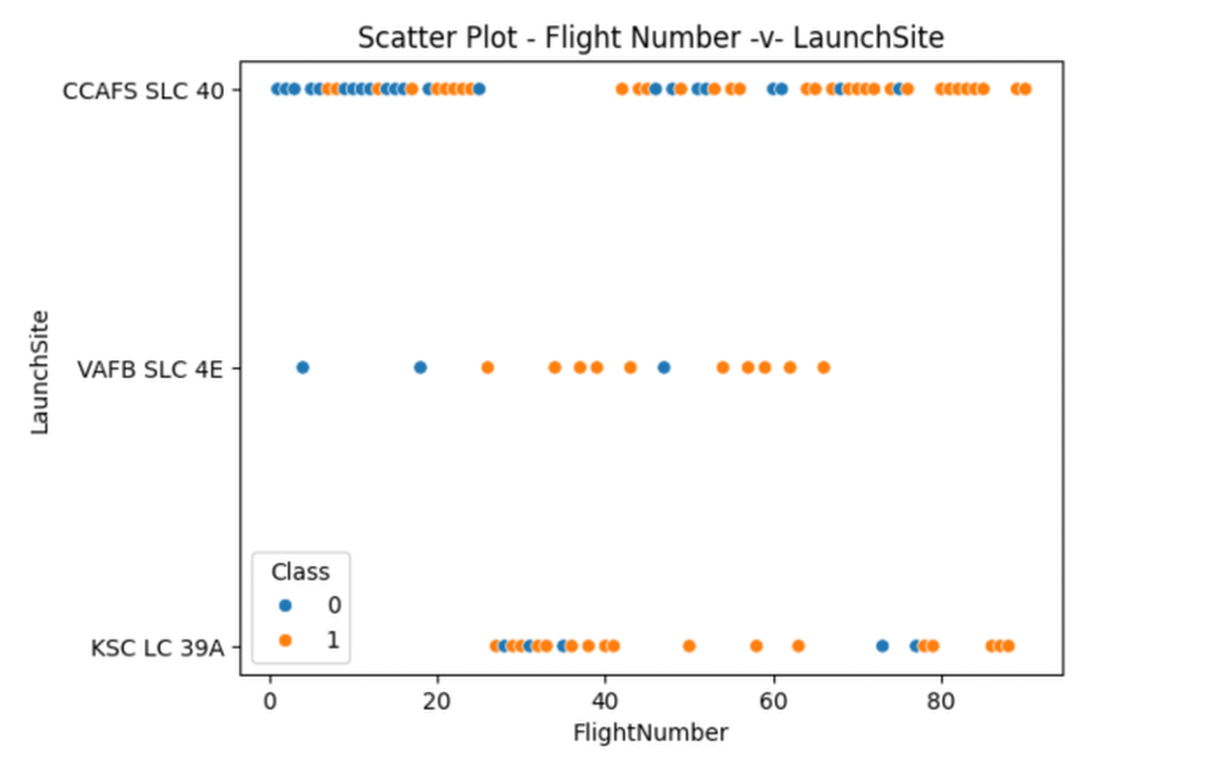
Flight Number vs. Launch Site
From the plot, we found that the larger the flight amount at a launch site, the greater the success rate at a launch site, LaunchSite appears to be the site where most of the successful launches have taken place.
Show the screenshot of the scatter plot with explanations

Slide 19
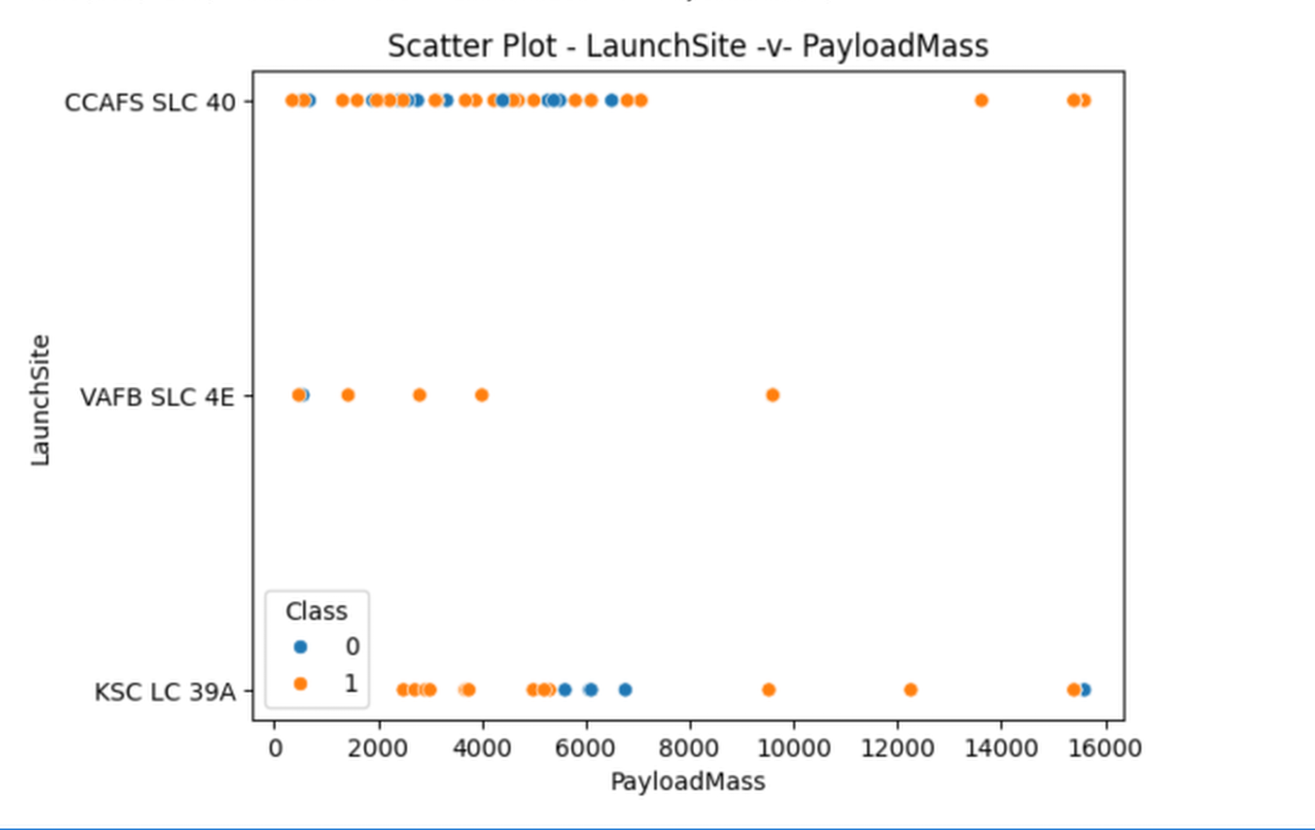
Payload vs. Launch Site
The greatest amount of launches with smaller PayloadMass appears to be at launch site CCAFS SLC 40

Slide 20
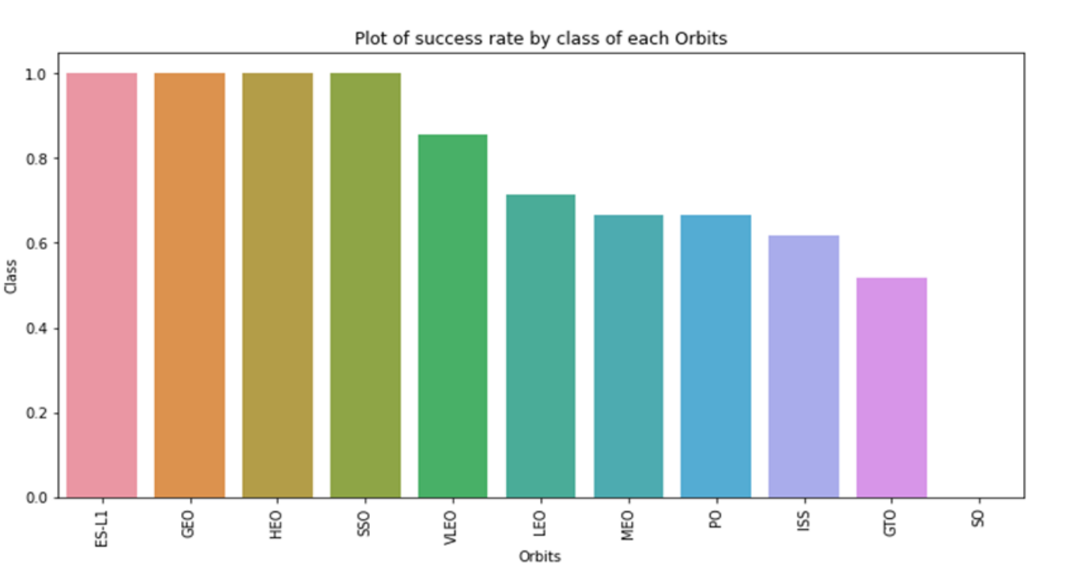
Success Rate vs. Orbit Type
Out of all the orbits ES-L1, GEO, HWO & SSO had the most successful orbits.

Slide 21
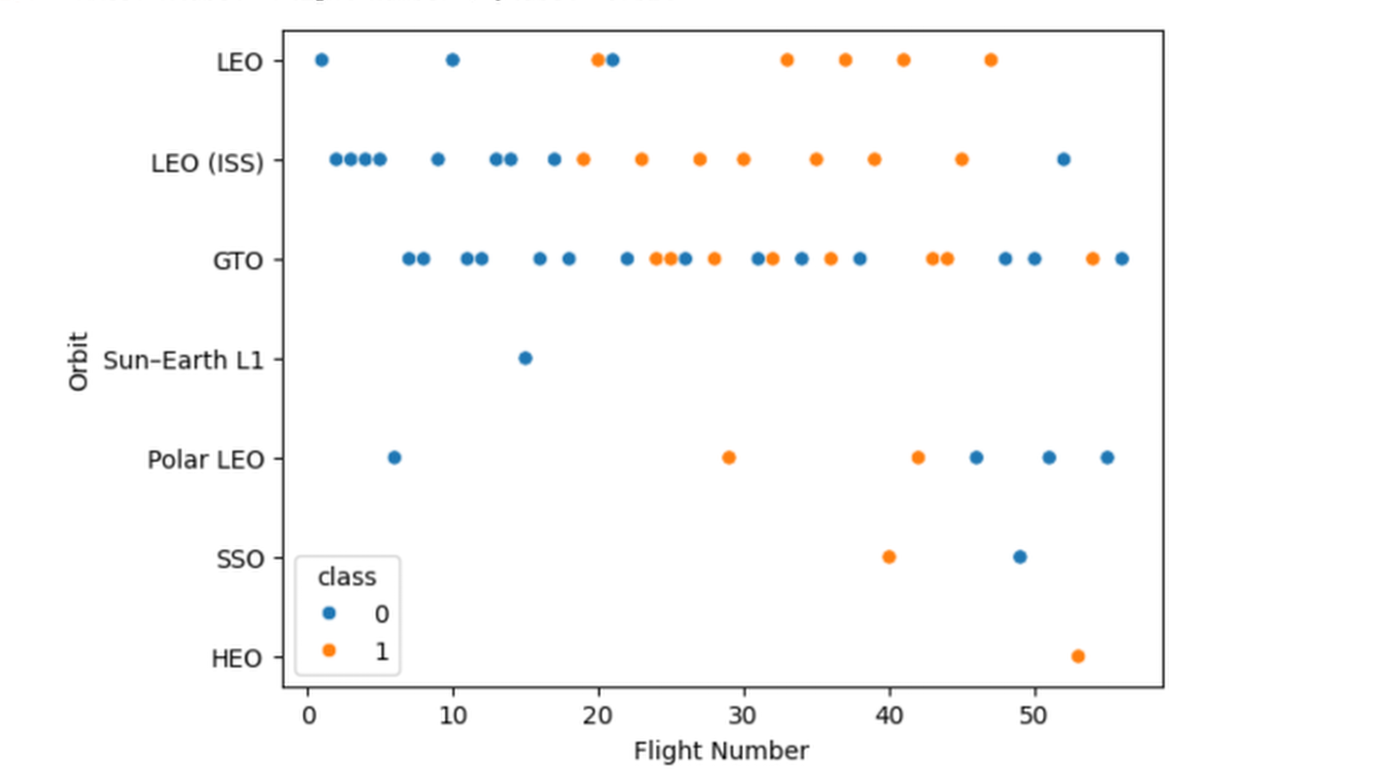
Flight Number vs. Orbit Type
So we can show that the successful launches have been under the LEO (ISS) orbit type, with regards to the GTO Orbit type the scatterplot shows no corelation at all.

Slide 22
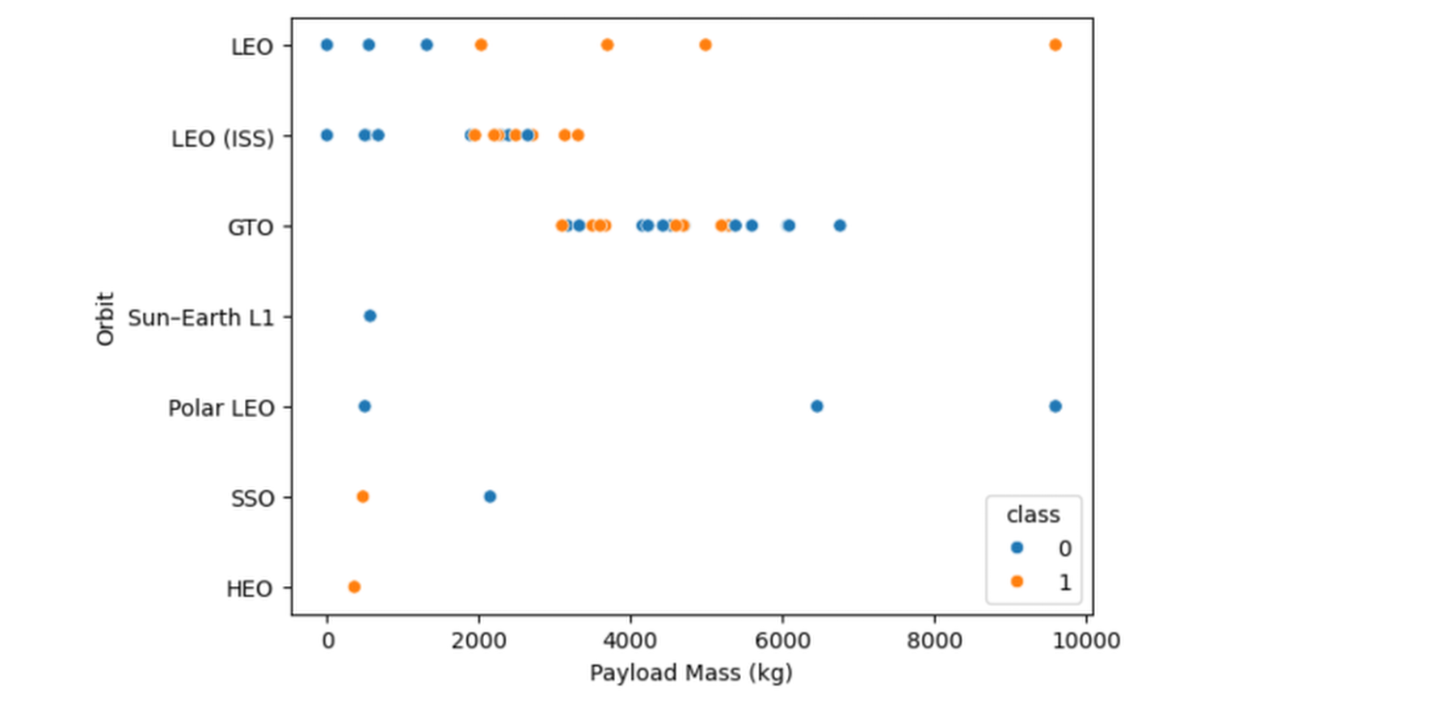
Payload vs. Orbit Type
We notice looking at this scatter plot that the higher the payload the more successful the orbits are.

Slide 23
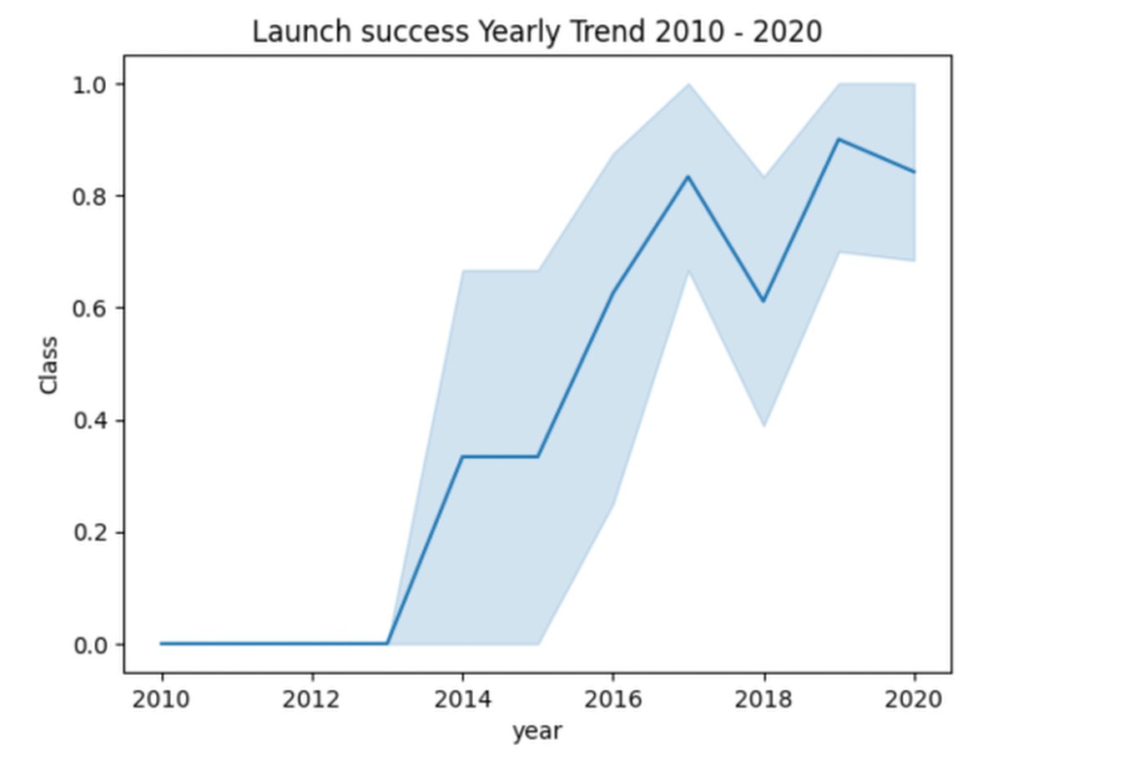
Launch Success Yearly Trend
We can see in the Trend line graph below that the Falcon 9 rocket started mid point of 2012 to launch successfully with a small drop in 2016 and then recovered in 2018.

Slide 24
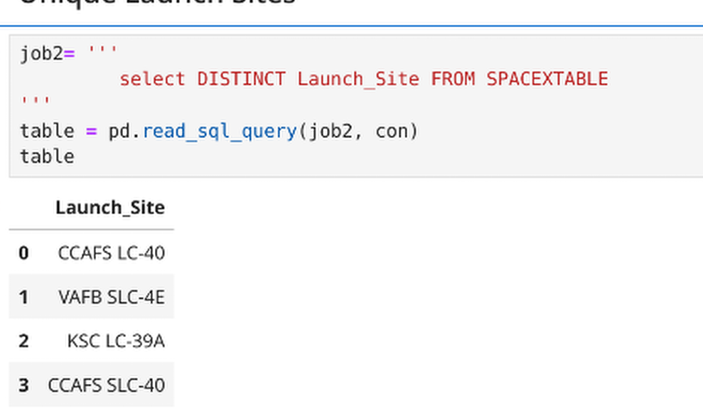
All Launch Site Names
In order to get the unique launch sites we used some sql code with the ‘DISTINCT’ sql command to only get the unique sites.

Slide 25
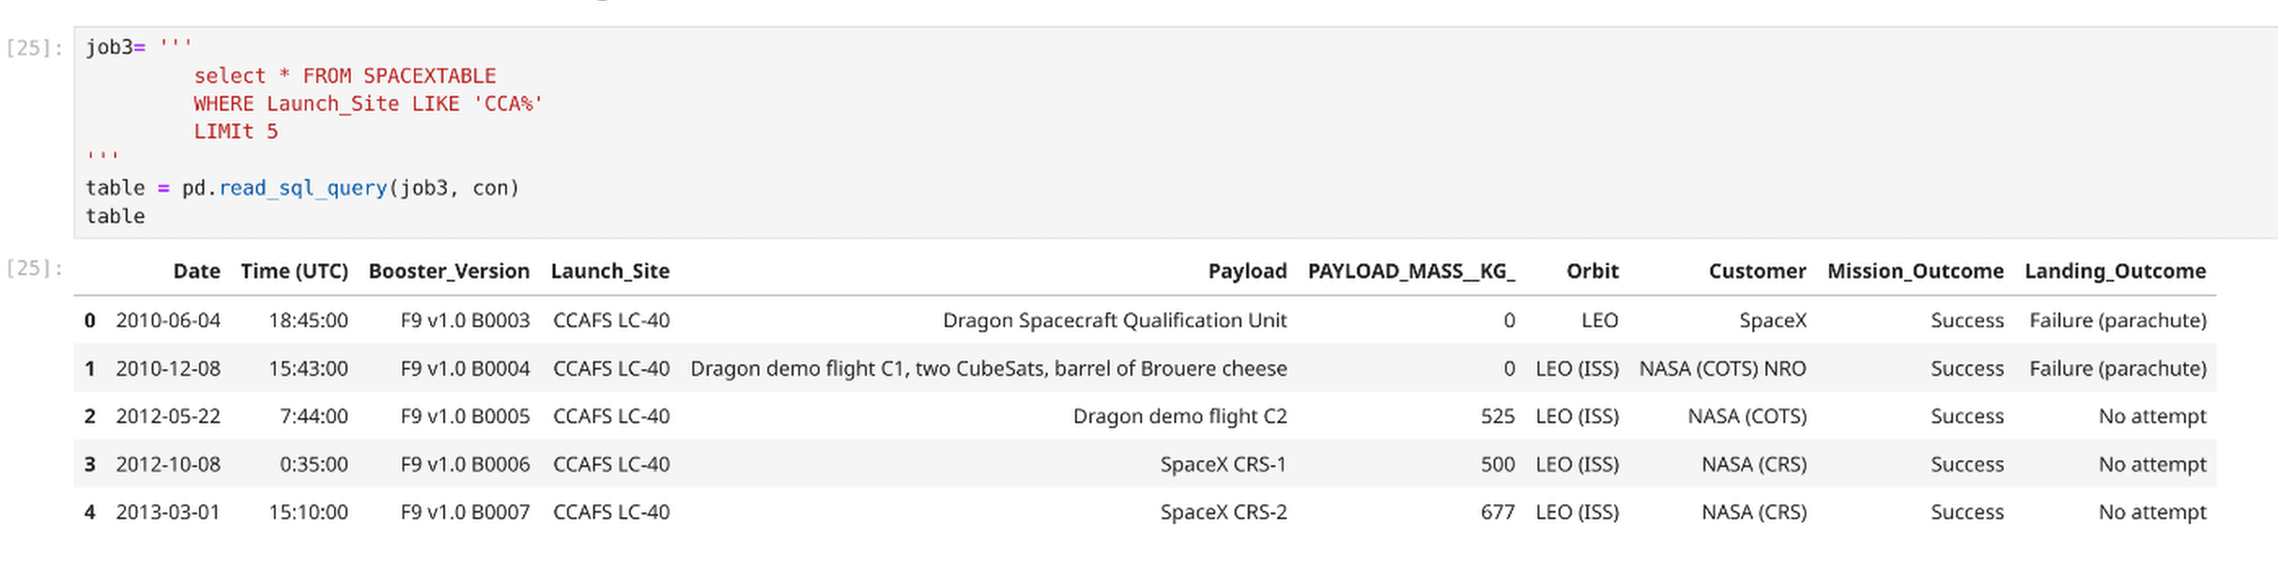
Launch Site Names Begin with 'CCA'
To do the search in SQL to find 5 Launch Sites that start with ‘CCA’ in the name we used the conditional stmt ‘WHERE’ for the launch_site column and then applied the ‘Like’ ‘CCA%’ command the ‘%’ is a wild card which says match any character after CCA, we then limit the results to 5 using the Limit command.

Slide 26
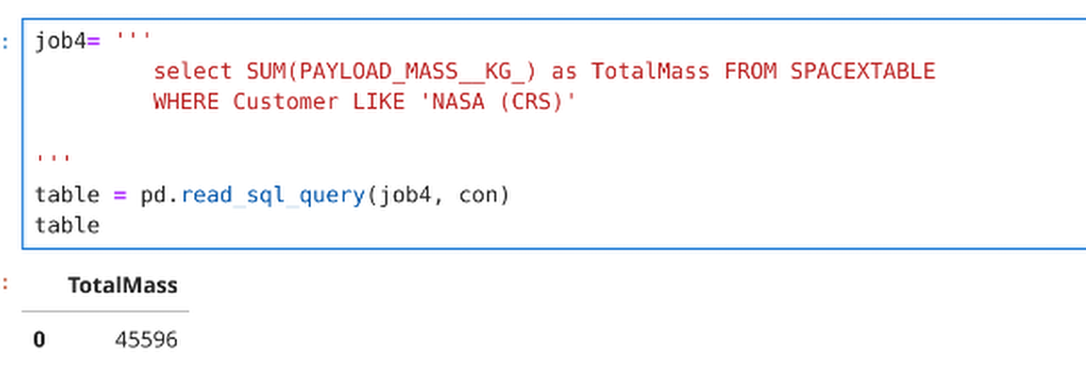
Total Payload Mass
To work out the Total Payload Mass in SQL we use the SUM command on the column ‘Payload_Mass_KG’ column within the data making sure that we are only interested in NASA for the customer using the WHERE conditional SQL stmt.

Slide 27
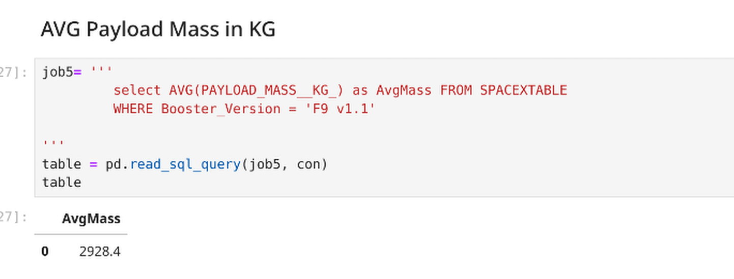
Average Payload Mass by F9 v1.1
To get the average figure for the F9 rocket Payload Mass we used the ‘AVG’ stmt on the ‘Payload_Mass__KG column making sure that we filtered on the Booster_Version. The result was 2928.4 for the average mass.

Slide 28
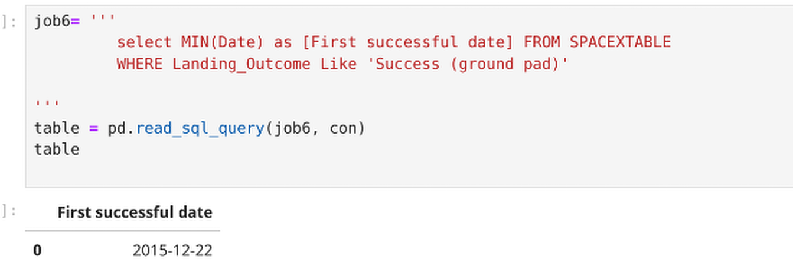
First Successful Ground Landing Date
To get the earliest 1st date of a successful ground landing we used the ‘Min’ stmts on the ‘Date’ column and filtered for ‘Success (ground pad). The 1st Successful date was 2015-12-22.

Slide 29
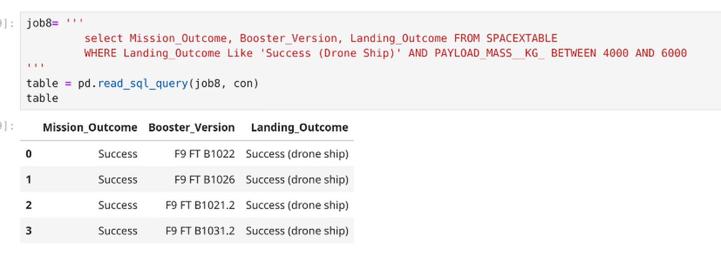
Successful Drone Ship Landing with Payload between 4000 and 6000
Below list the results of the Drone Ships that successfuly landed that carried an original payload mass of between 4,000 and 6,000 KG’s.

Slide 30
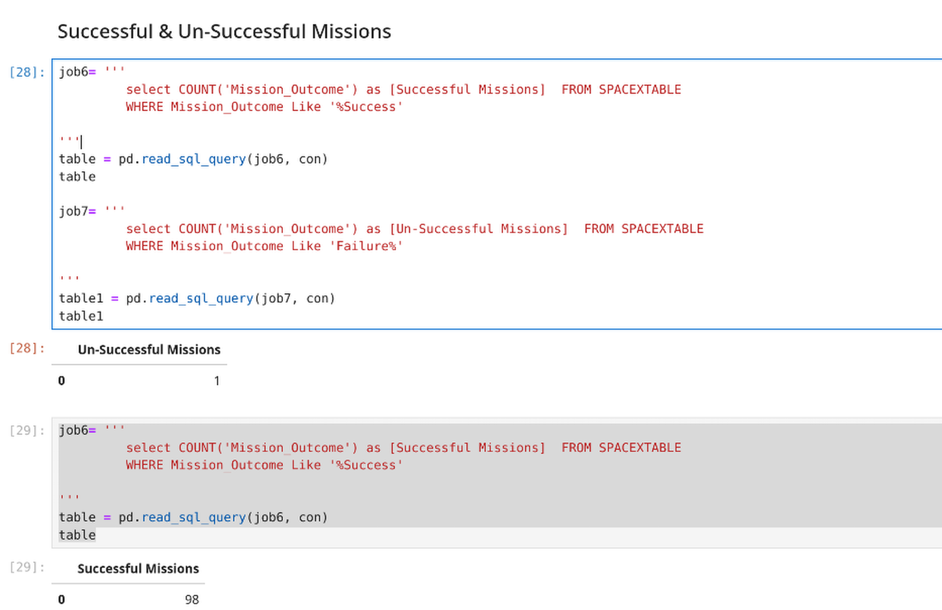
Total Number of Successful and Failure Mission Outcomes
To the left shows 1st the Un-Successful missions of 1 and below that the successful missions of 98, filtering on the Mission outcome column for ‘%Success’ or ‘Failure%’.

Slide 31
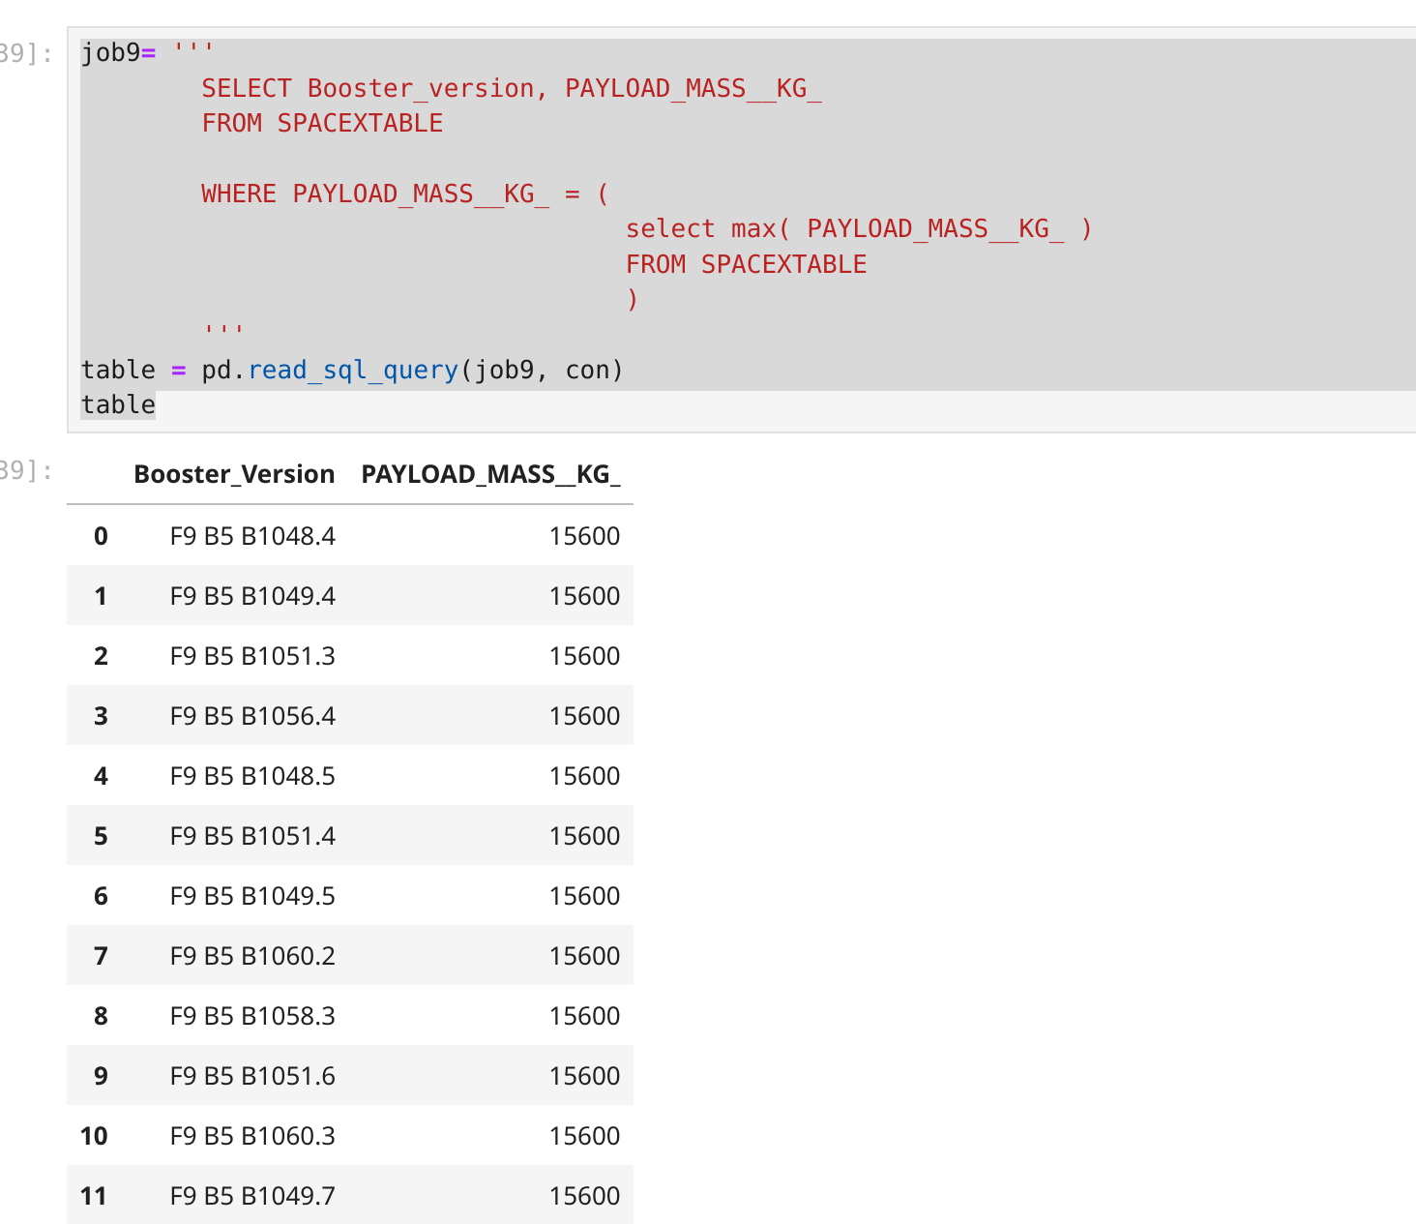
Boosters Carried Maximum Payload
This table lists all the booster_Versions with the Max Payload they carried.

Slide 32
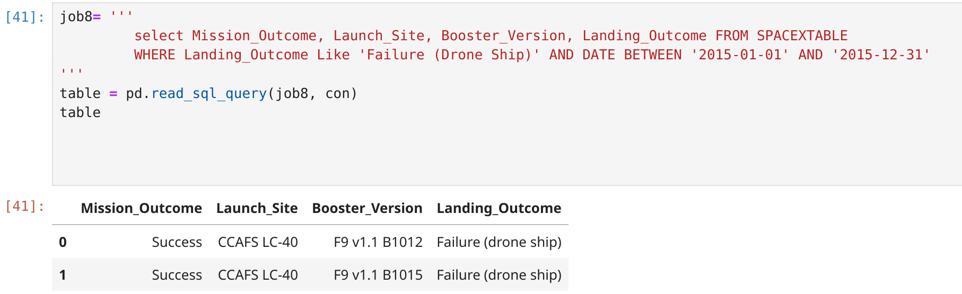
2015 Launch Records
Below is the table showing the failed landings in the 2015 with the Booster_Versions and Launch sites indicated.

Slide 33
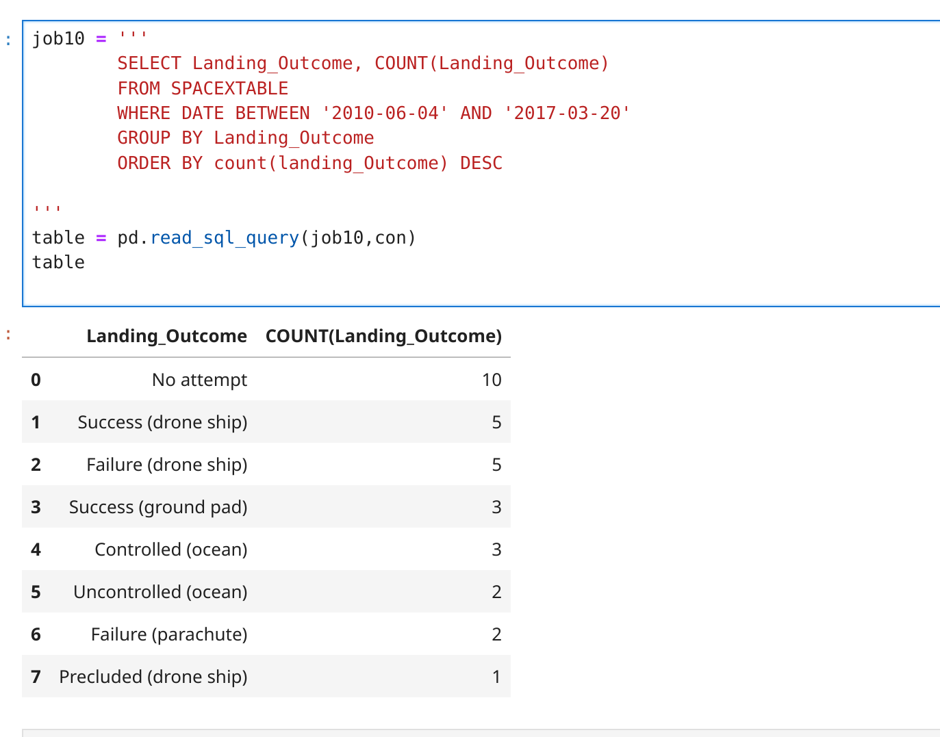
Rank Landing Outcomes Between 2010-06-04 and 2017-03-20
The table (left) shows the number of catagories in landing outcomes between June 2010 and March 2017, we notice that ‘No attempt’ landing outcome was the highest occurances of 10.
We used the ‘group by’ stmt on Landing Outcomes to group all the outcomes together then ‘ordered by’ sql stmt in descending order.

Slide 34

Section 3

Slide 35
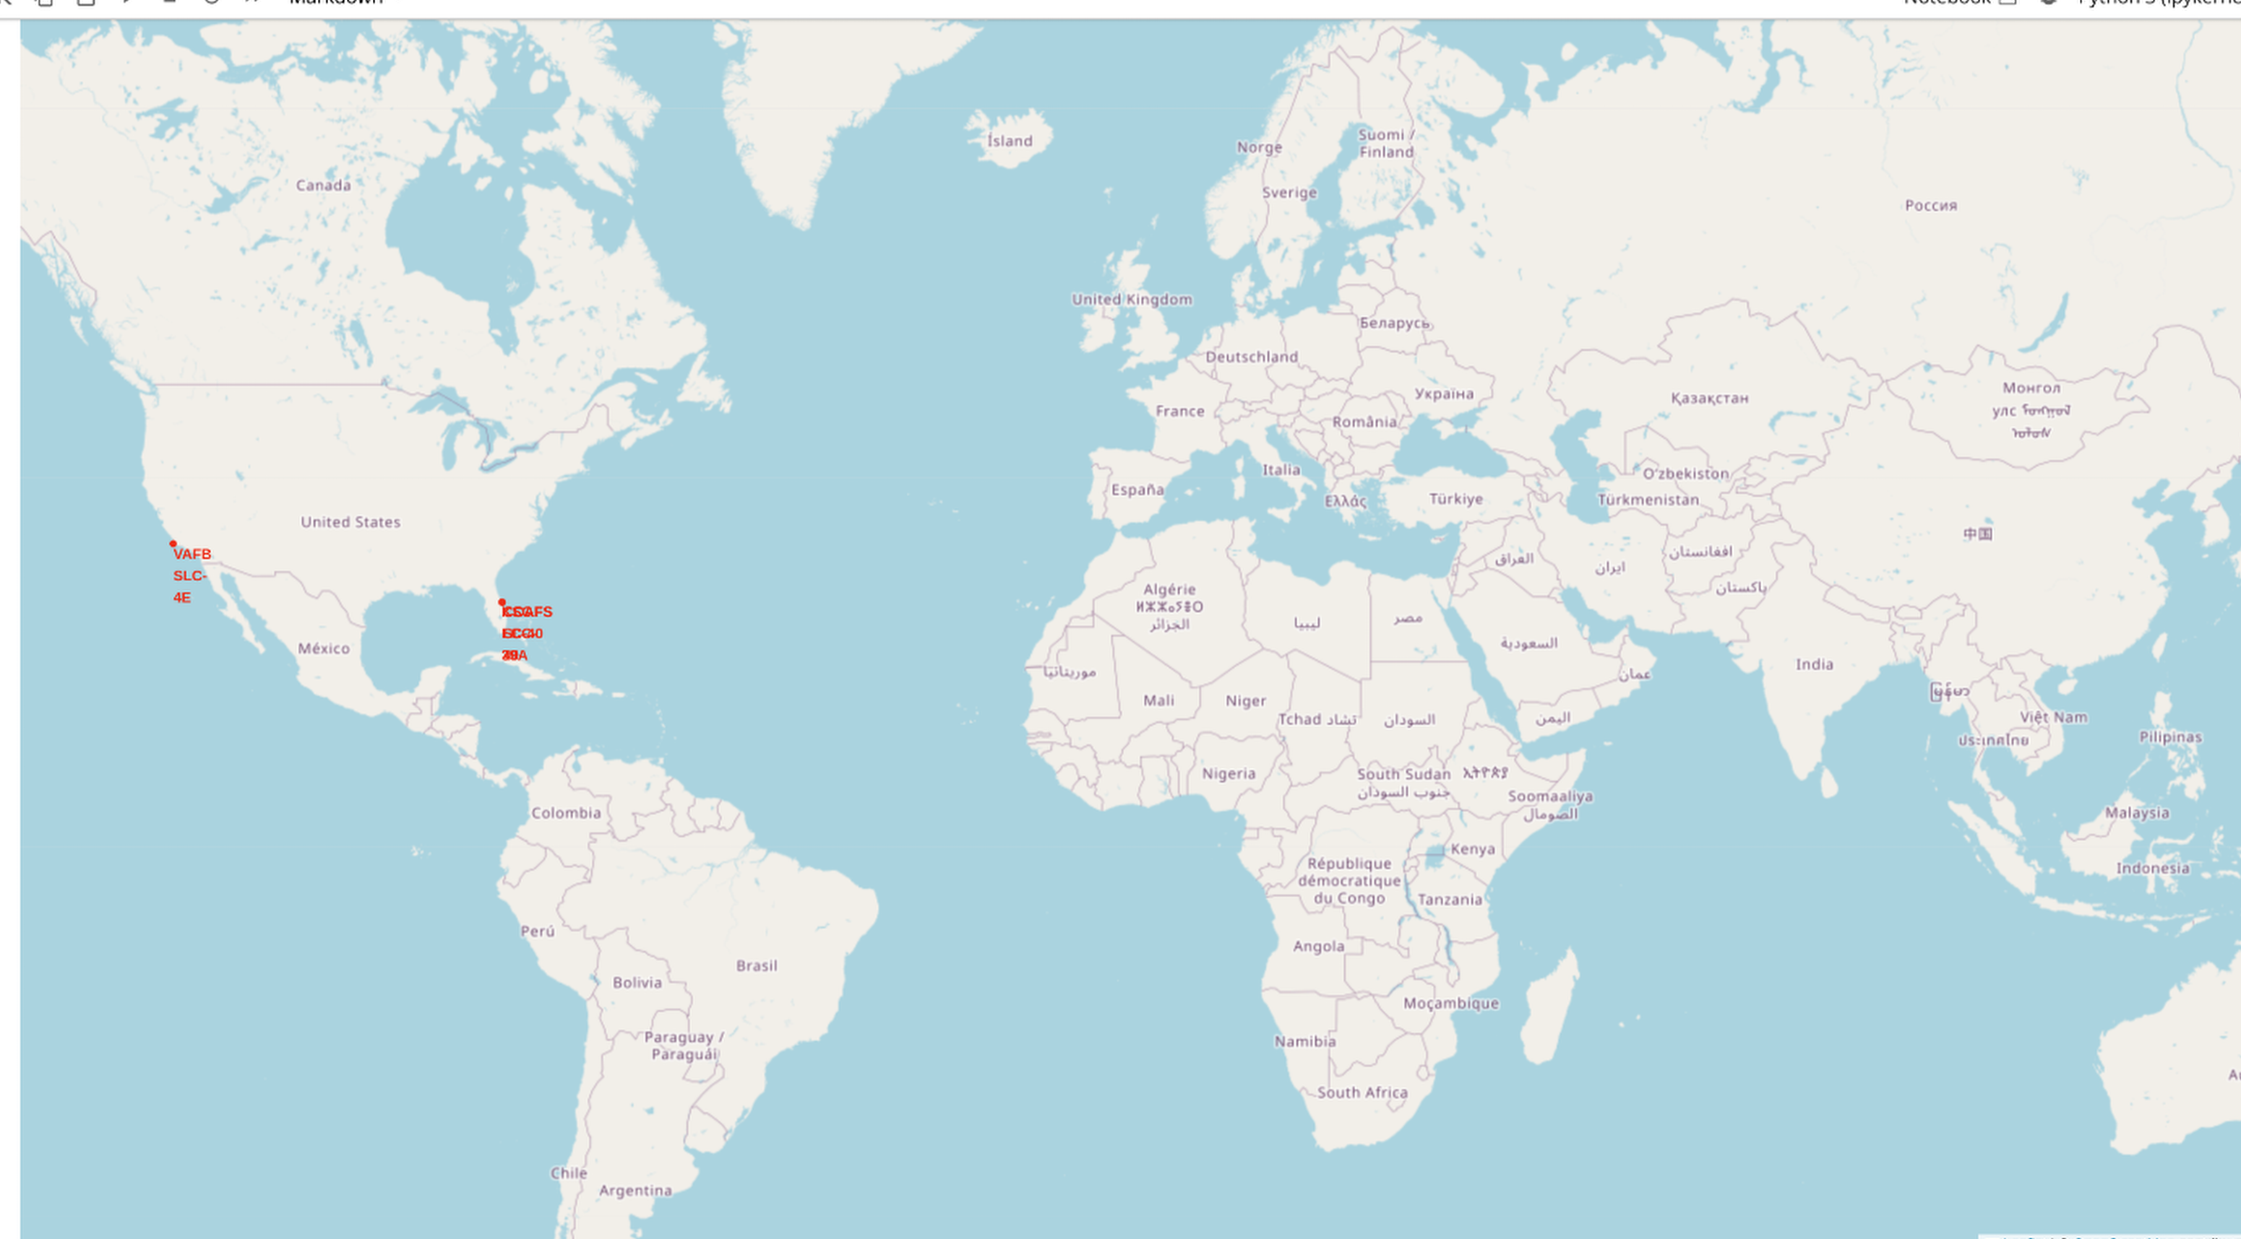
A Map of the SpaceX Launch sites
We can see that there is a launch site at Vandenberg Space force site and a further site in Florida.
Replace <Folium map screenshot 1> title with an appropriate title
Explore the generated folium map and make a proper screenshot to include all launch sites’ location markers on a global map
Explain the important elements and findings on the screenshot

Slide 36
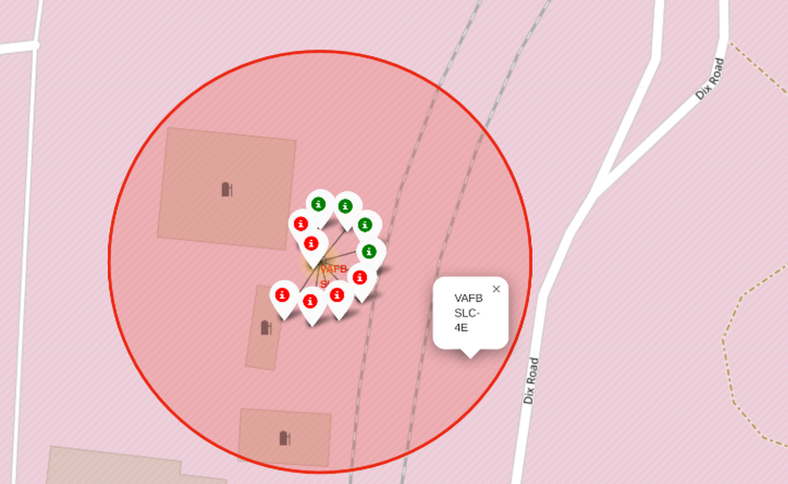
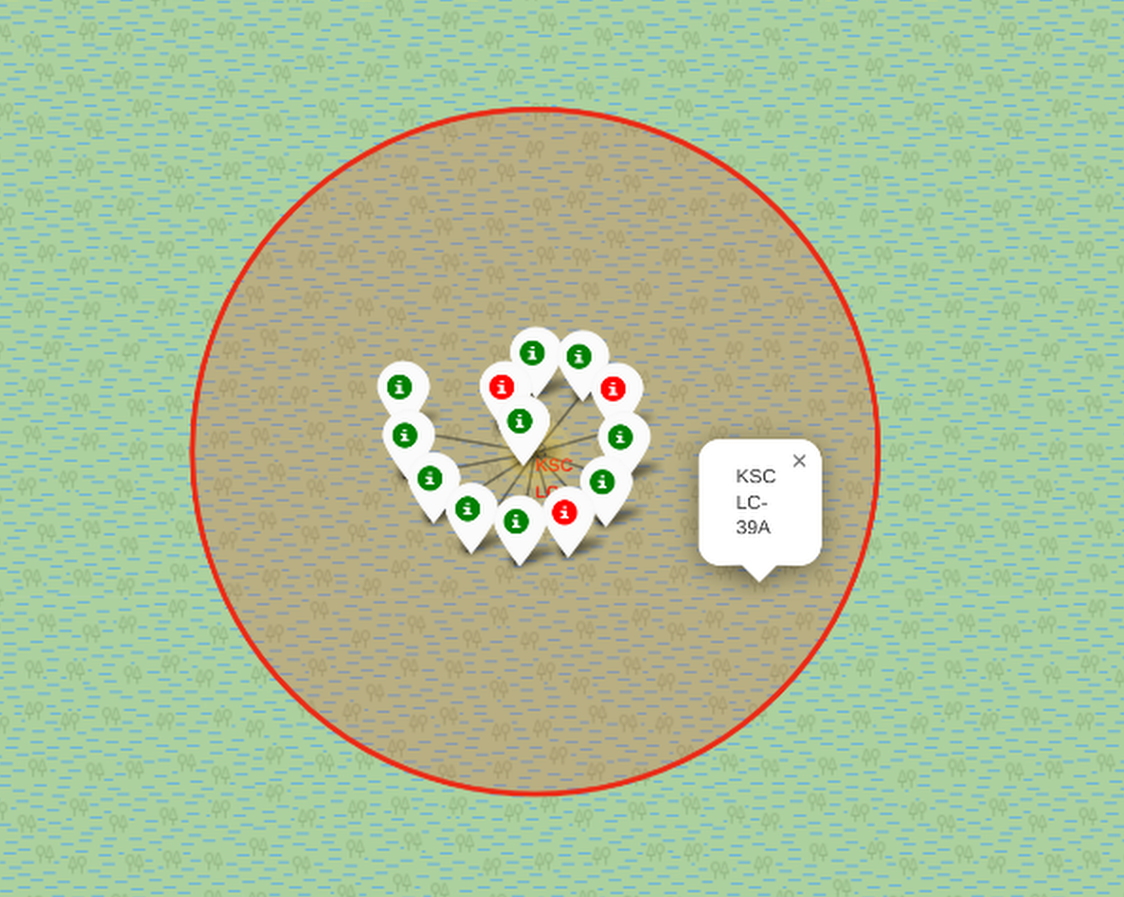
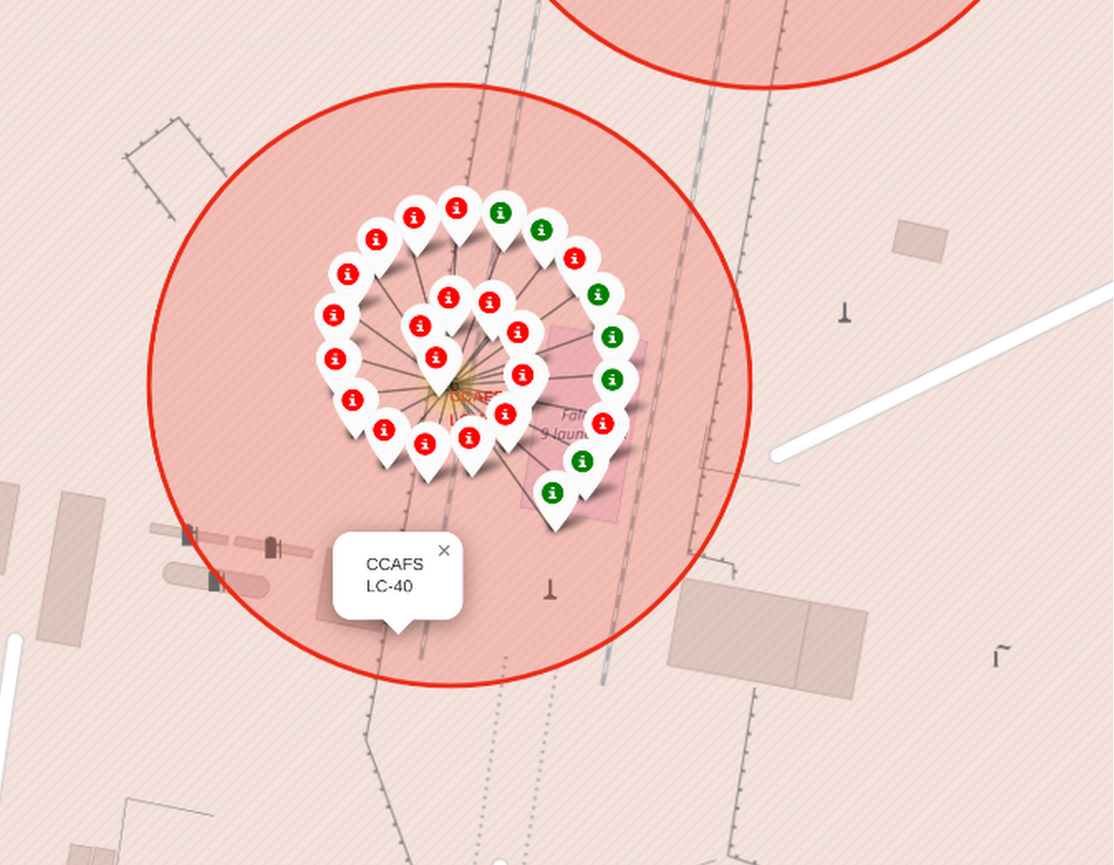
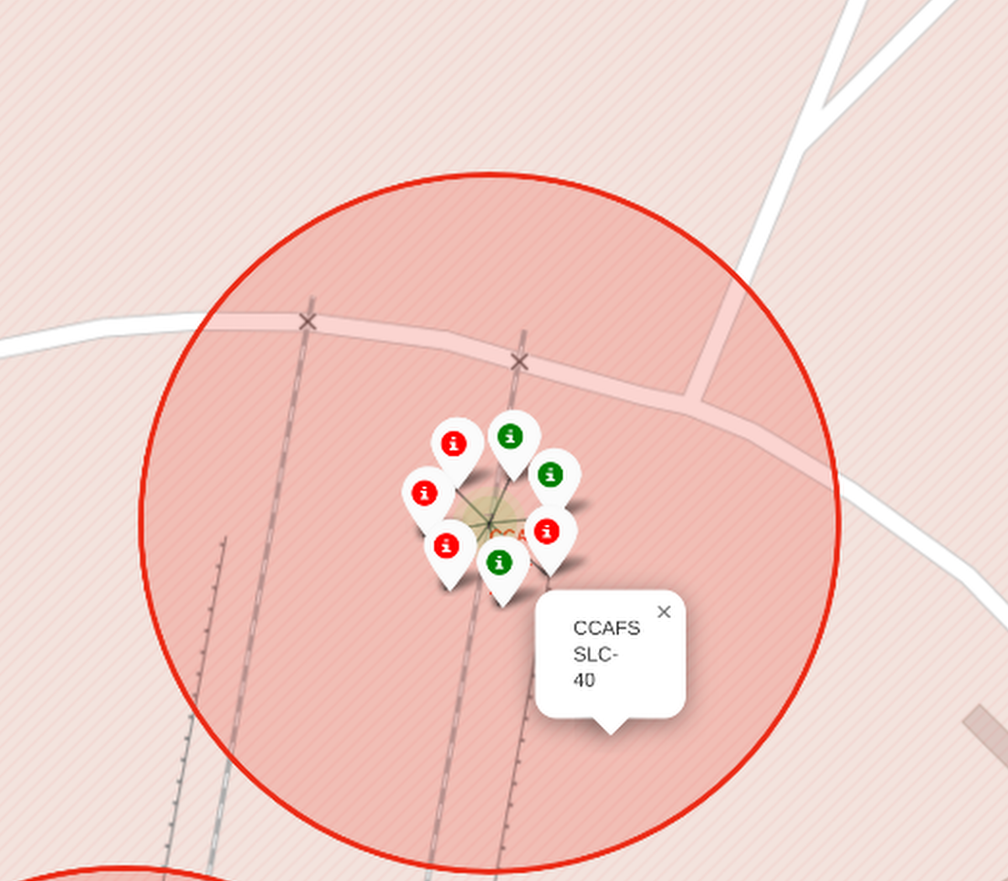
Successful & Un-successful SpaceX launches
The Picture to the left shows in Green the successful launches and Red the un-successful launches at the California site
The 3 pictures below shows in Green the successful and Red the Un-Successful launches at the Florida sites.

Slide 37
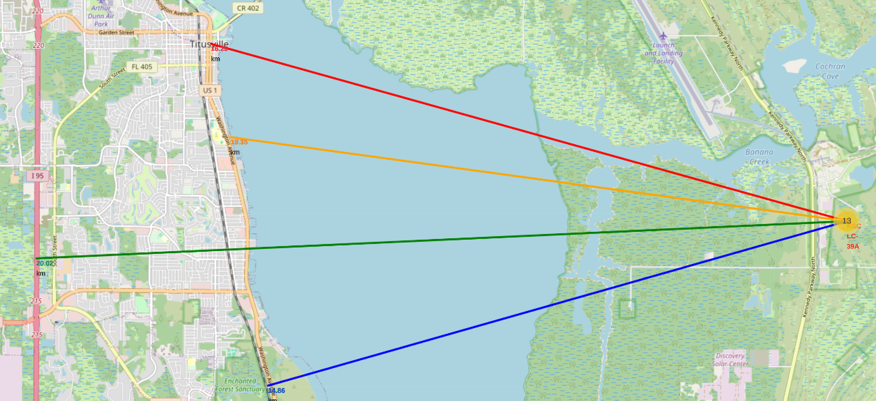
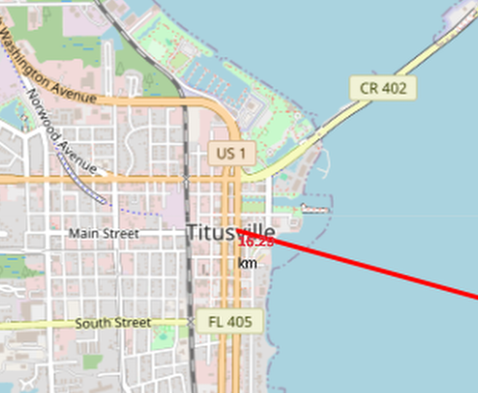
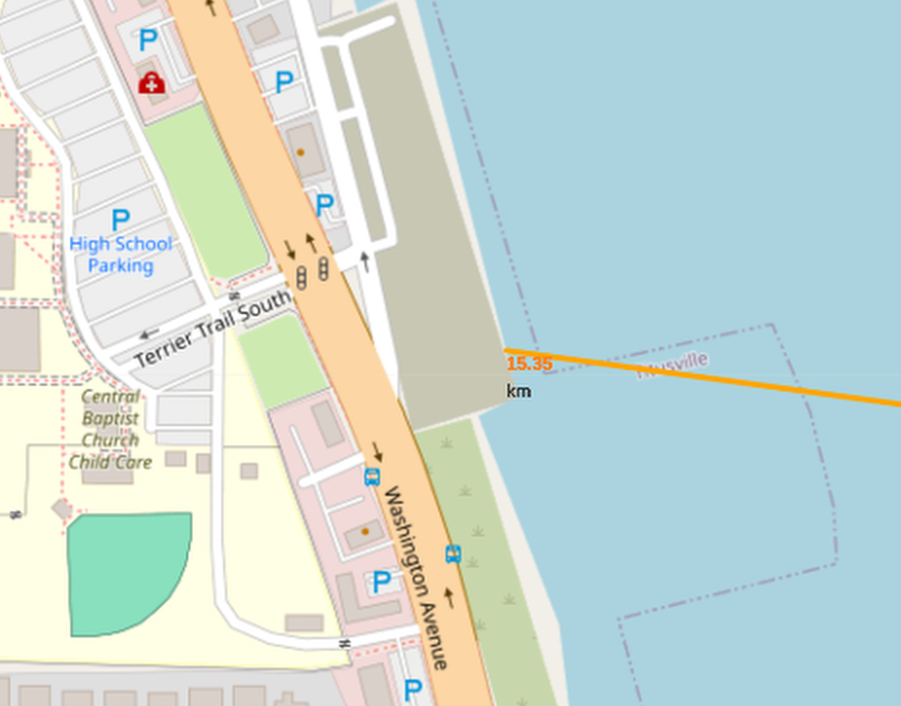
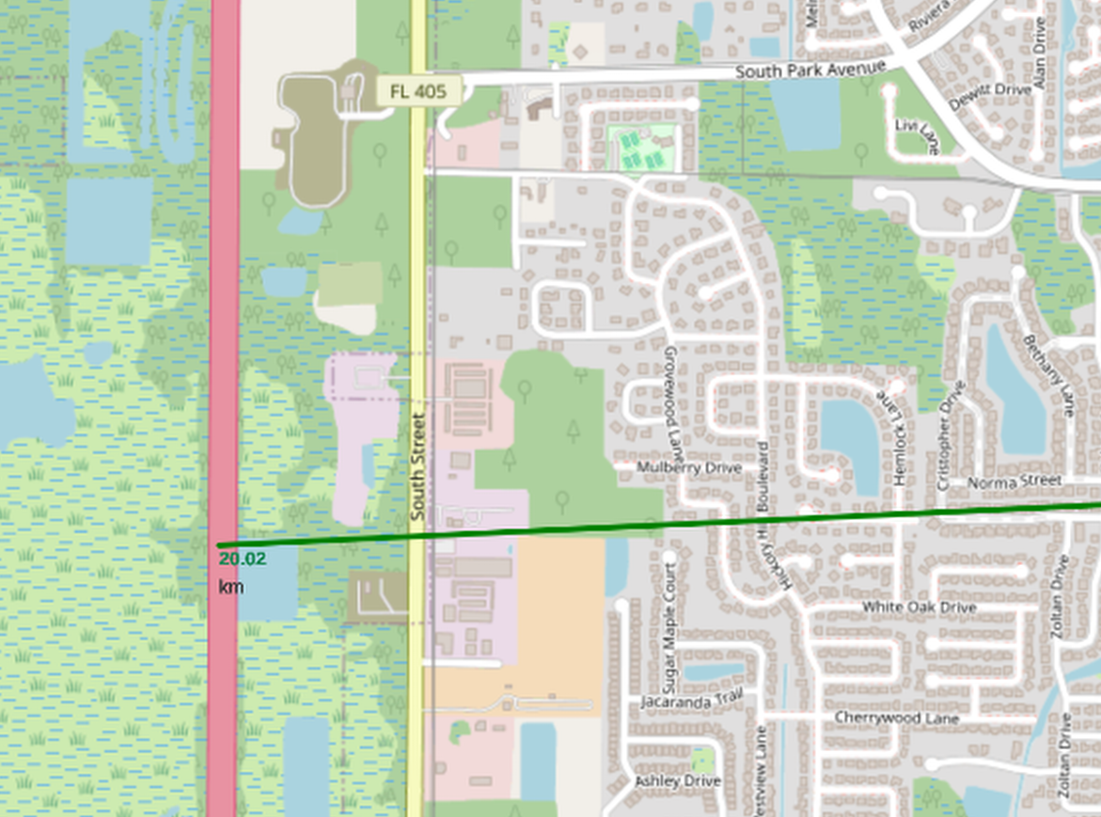
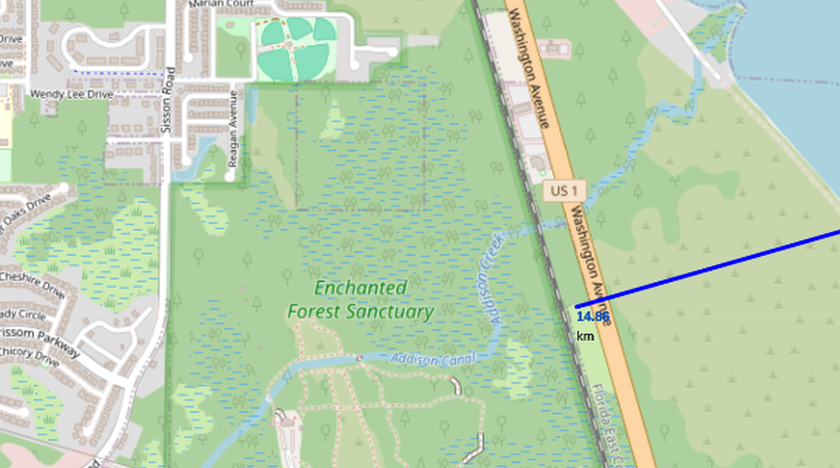
Distance to Nearest City,Coastline,Highway and RailwayTrack from Florida Launcher
Map to left shows all the important sites in relation to the the florida launch site KSCLC-39A
- Red line nearest city Trustville 16.29 Km’s away
- Orange line coastline 15.35 Km’s away
- Green line main Road 215 20.02 km’s away
- Blue line Nearest Railway Line 14.98 km’s away
Pictures below are closeups of the above.

Slide 38

Section 4

Slide 39
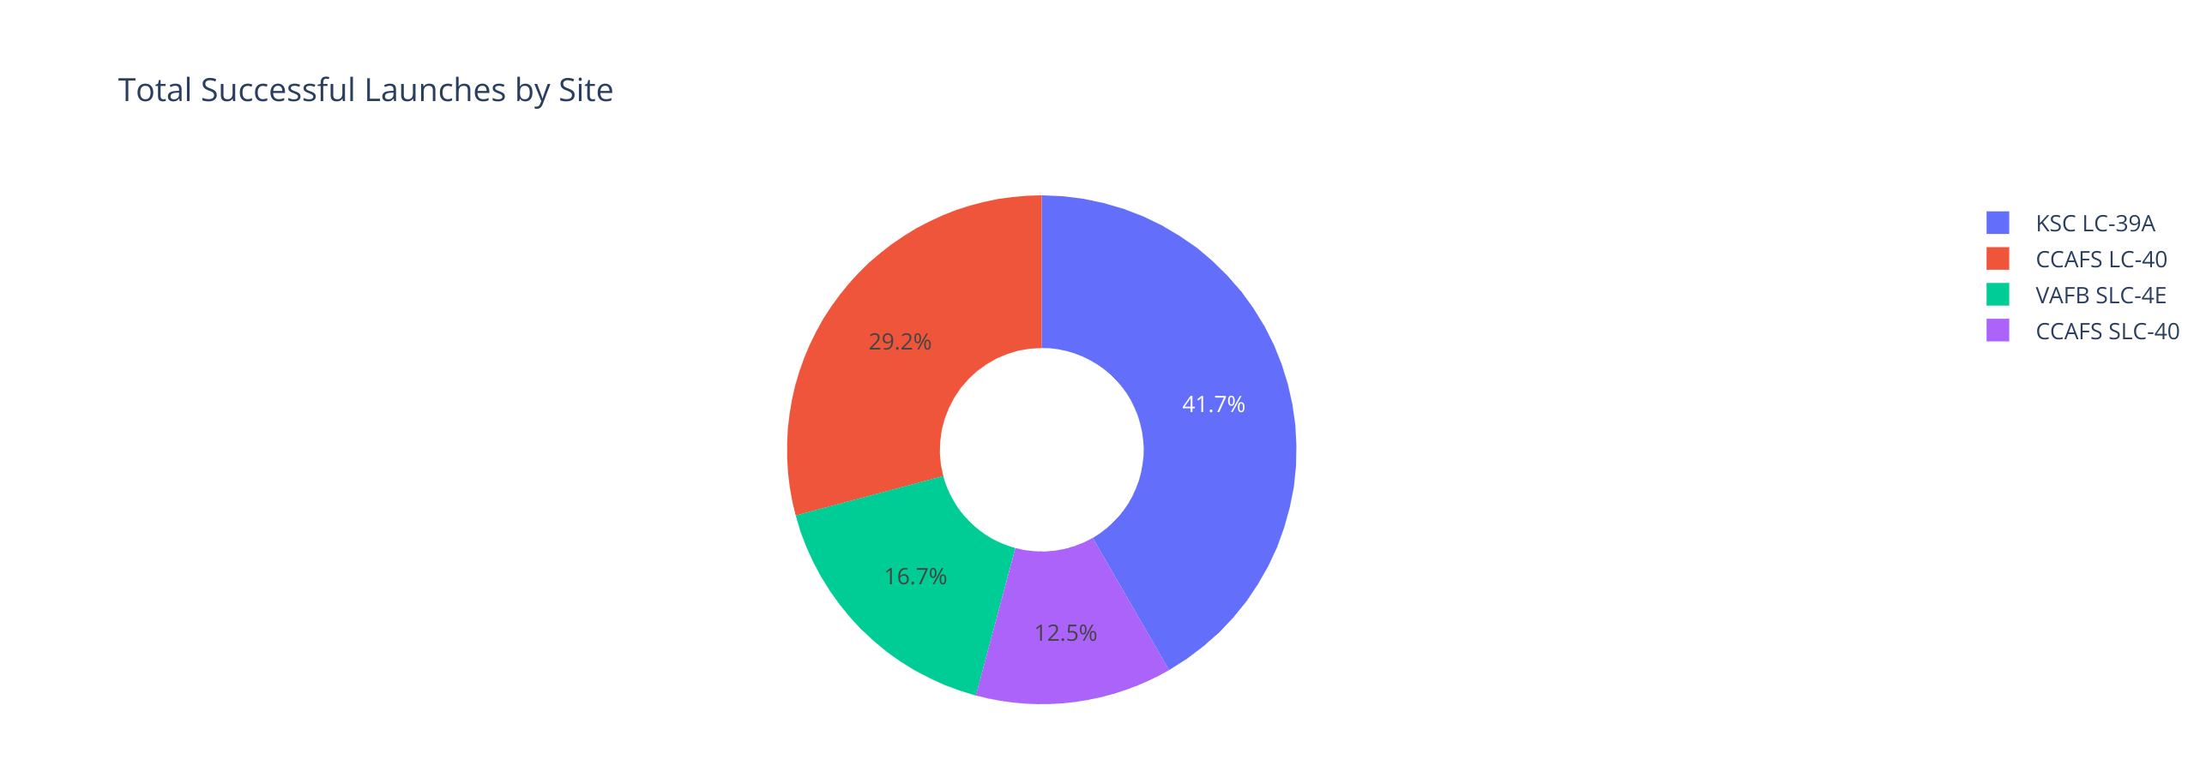
Pie Chart showing the % of successful Launches by site
Replace <Dashboard screenshot 1> title with an appropriate title
Show the screenshot of launch success count for all sites, in a piechart
Explain the important elements and findings on the screenshot
Hover over chart to get the counts of launches for each site, launch site KSC LC-39A had 10 successful launches
We can see that Launch site KSC LC-39A had the highest number of Successful Launches

Slide 40
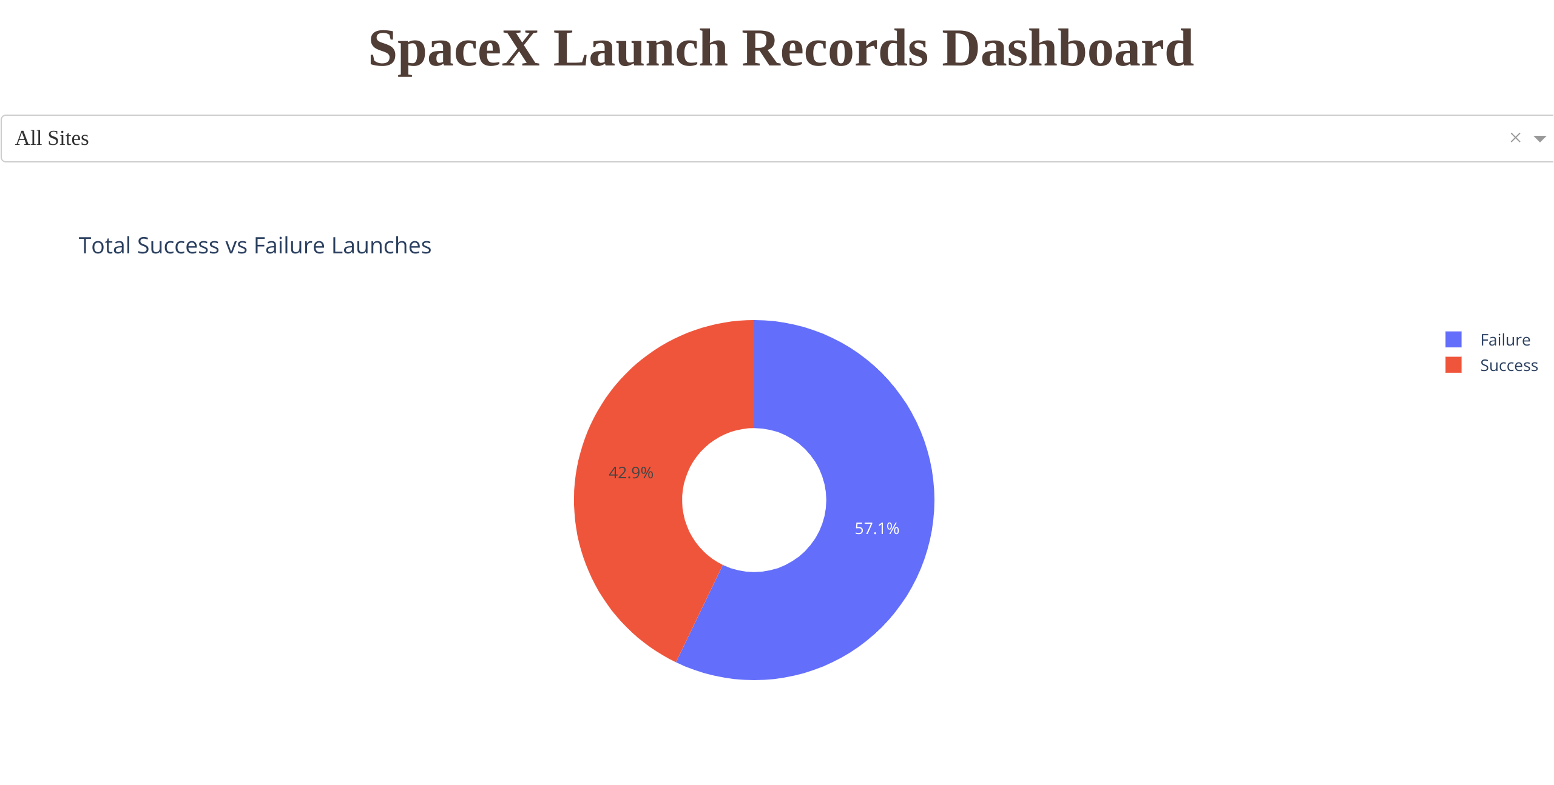
Pie chart showing the % in Successful -v- Un-successful Launches
Replace <Dashboard screenshot 2> title with an appropriate title
Show the screenshot of the piechart for the launch site with highest launch success ratio
Explain the important elements and findings on the screenshot
There where slightly more failures then successful launches of the SpaceX rockets.

Slide 41
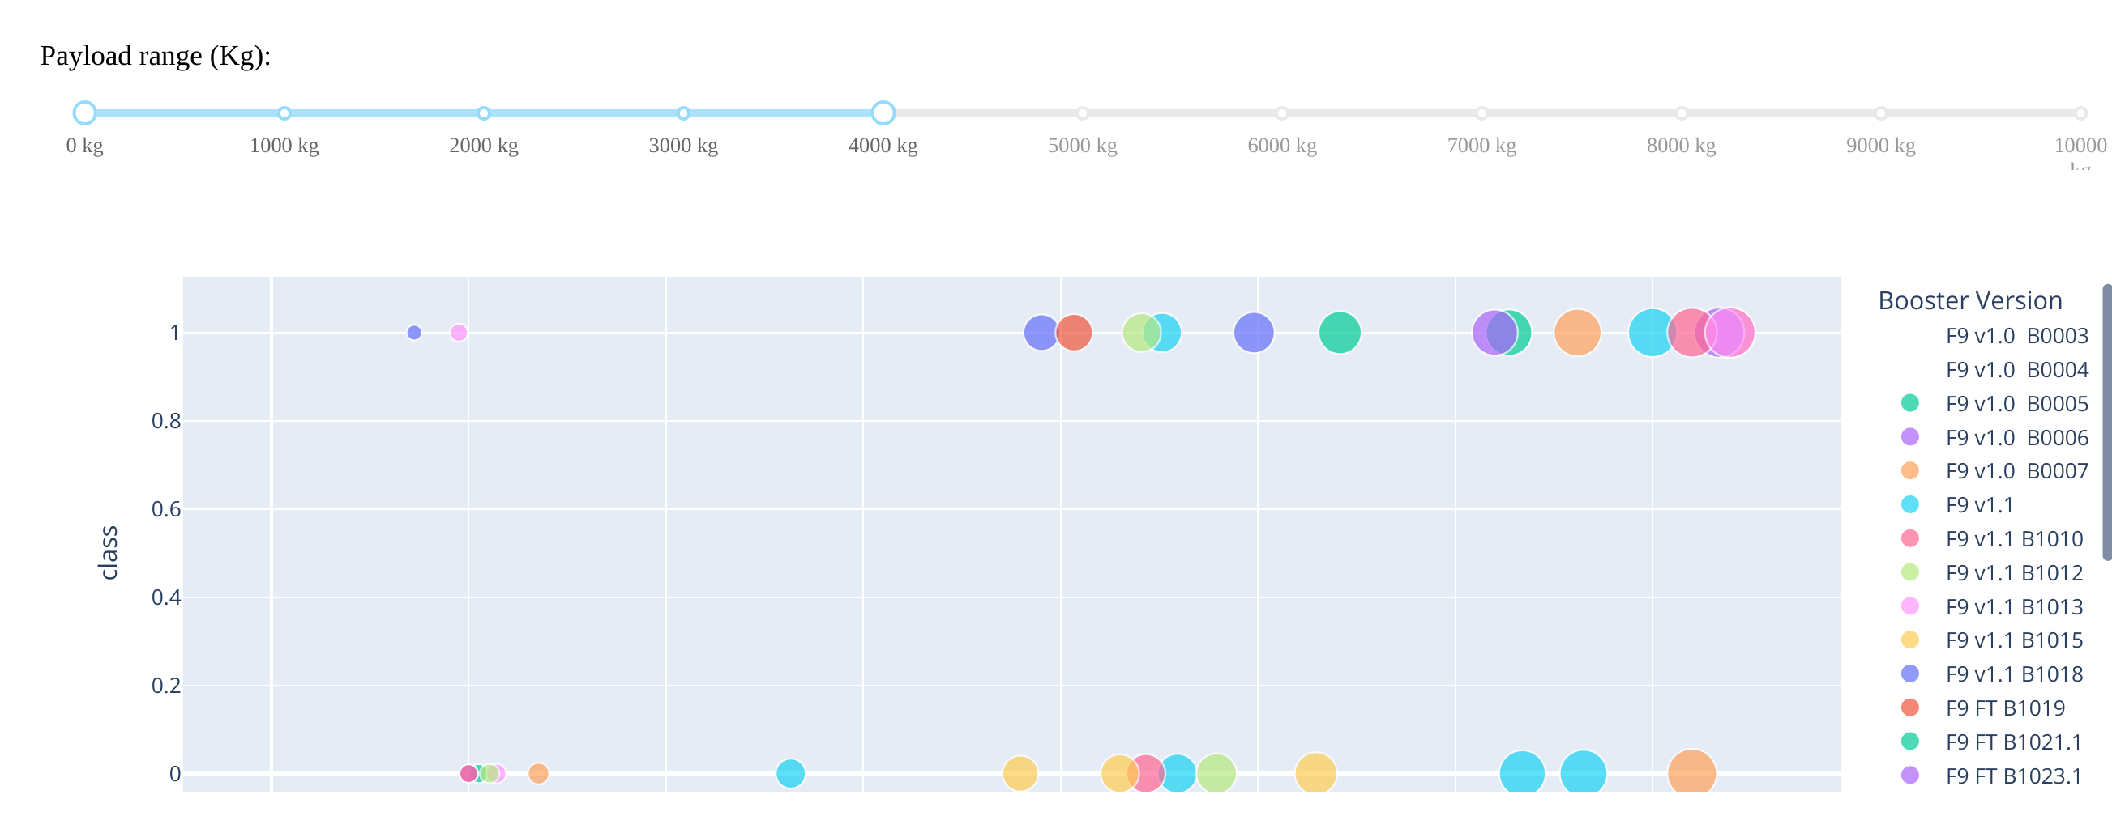
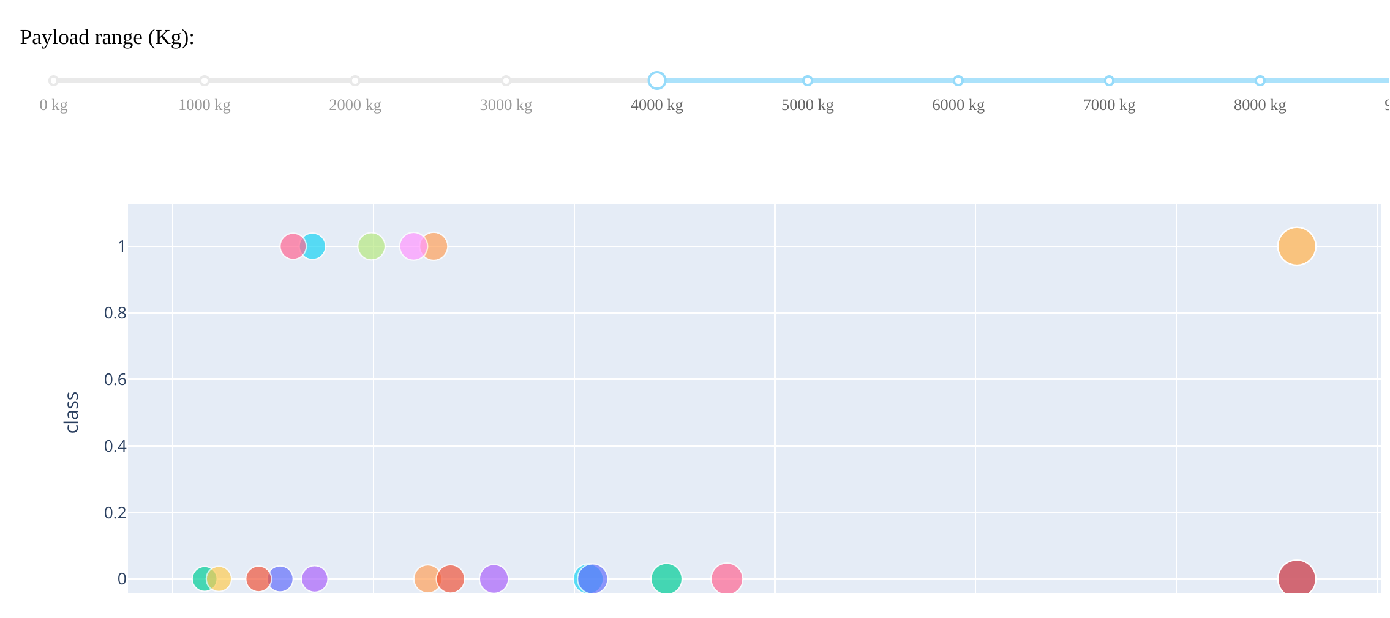
Scatter Plots showing frequency of successful -v- Un-Successful launches based on Payload
When looking at both the scatterplots the top one shows that we had more successful launches when the payload in the particular rocket is from 4,000kg’s in weight and under
The 2nd scatter plot at the bottom shows that we had many more unsuccessful launches when the payload was 4,000kg and above.

Slide 42

Section 5

Slide 43
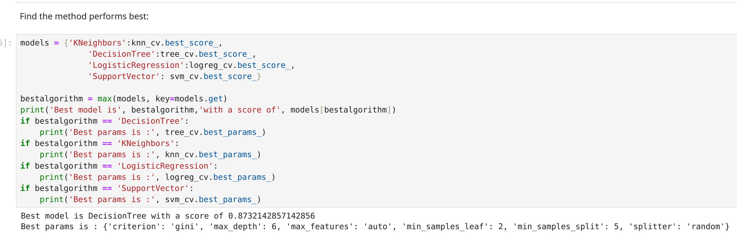
Classification Accuracy
The best learning model turned out to be the DecisionTree model as shown below.

Slide 44
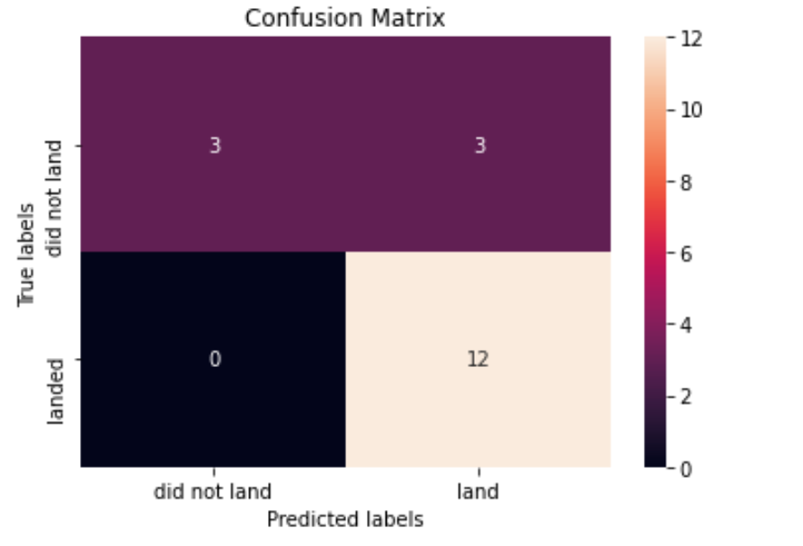
Confusion Matrix
We can see from the Confusion Matrix using the Descision Tree model that it can recognise the SpaceX rockets that landed correctly but the problem is with the those rockets that did not land but are recognised as landed of which there are 3 incorrectly identified as landed when they did not.

Slide 45
Conclusions
The 3 Launch Sites with the most successful launches where:- CCSFS KSC VAFB
2013 was the year when SpaceX started to successfully launch it’s Falcon 9 rockets
When the payload was 4,000kg’s in weight we noticed there where more successful launches then when the payload was 4,000kg’s and above.
In Machine Learning the model that gave the best acurate prodictions in successful launches was the Deicision Tree model.

Slide 46
Appendix
Include any relevant assets like Python code snippets, SQL queries, charts, Notebook outputs, or data sets that you may have created during this project

Slide 47


